Slide 1
Alaska Winter 2019-20 Climate Review and Spring 2020 Outlook
Rick Thoman
Alaska Center for Climate Assessment and Policy
April 21,2020

Slide 2
Today’s Agenda, Part 1
What’s Happened
Temperature flip mid-December
Precipitation more consistent
What’s the Weather/Climate Outlook through May
Odds tilt toward above normal temperatures…at least after next week
No significant tilt in precipitation
does NOT mean near normal: above, below and near normal equally likely

Slide 3
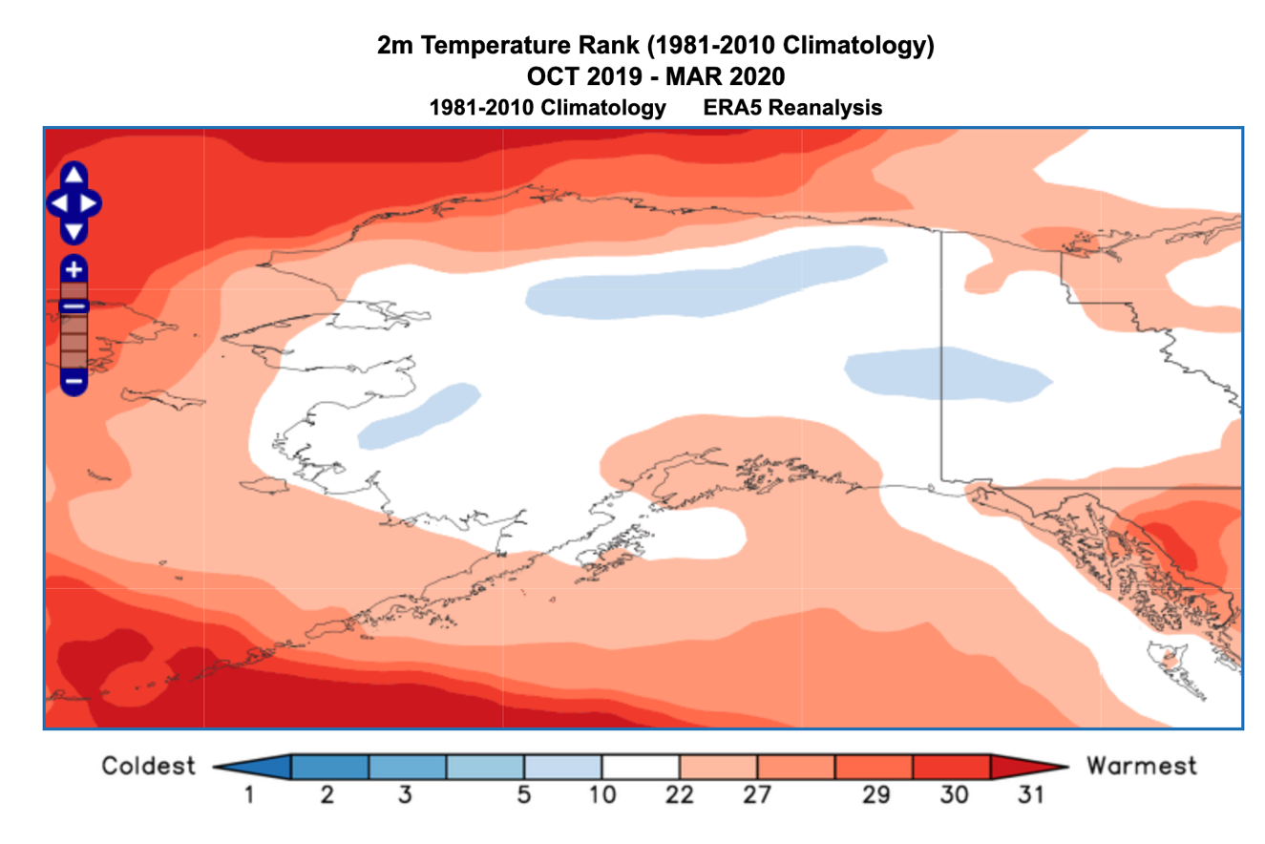
Cold Season 2019-20 A lot of near normal

Slide 4
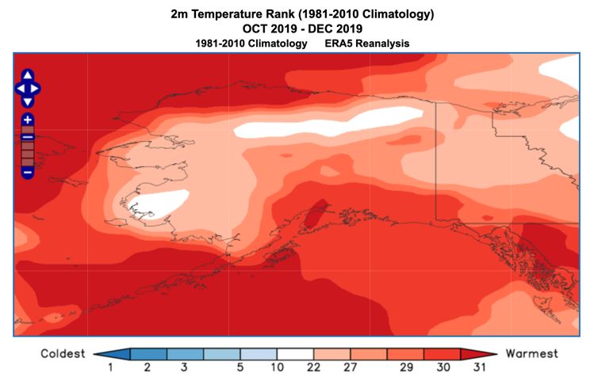
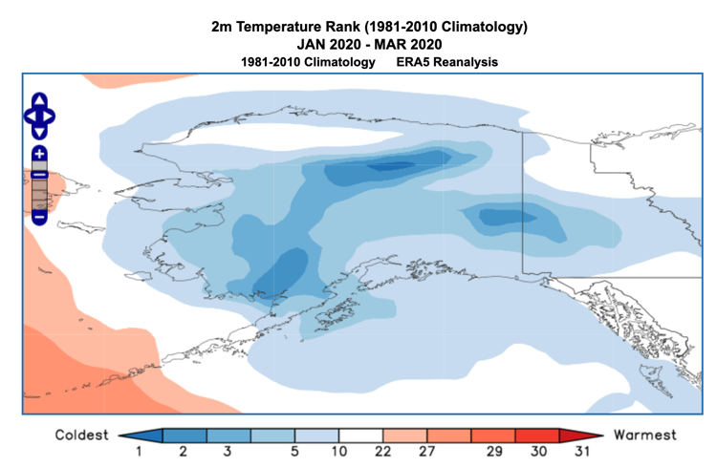
A Tale of Two Winters
Oct-Dec 2019
Jan-Mar 2020

Slide 5
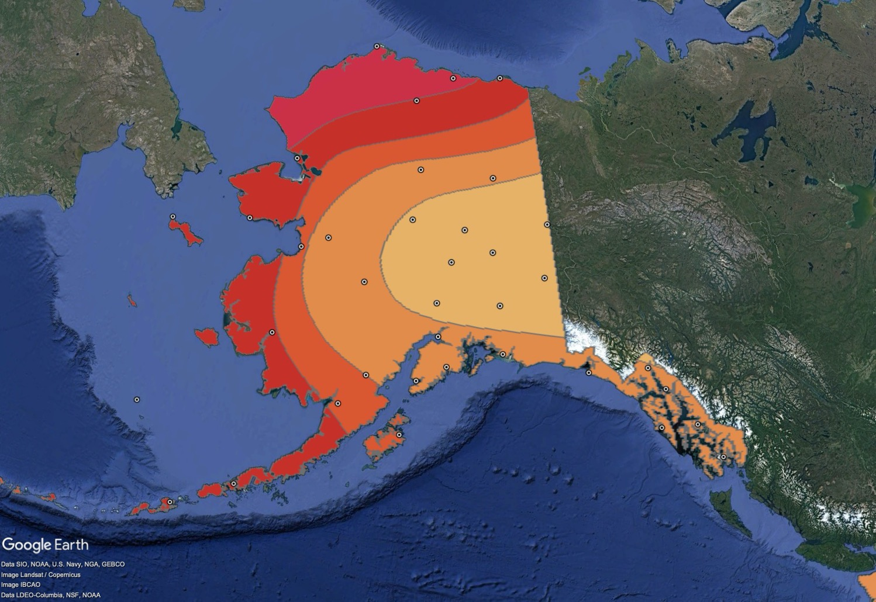
Oct-Nov-Dec 2019 Temperature Anomalies
For areas CPC tilted the odds:
Percent correct: 100%
Observed
Skill Score: +100
Above Normal
Near Normal
Below Normal
Preliminary NOAA/NWS data subject to revision

Slide 6
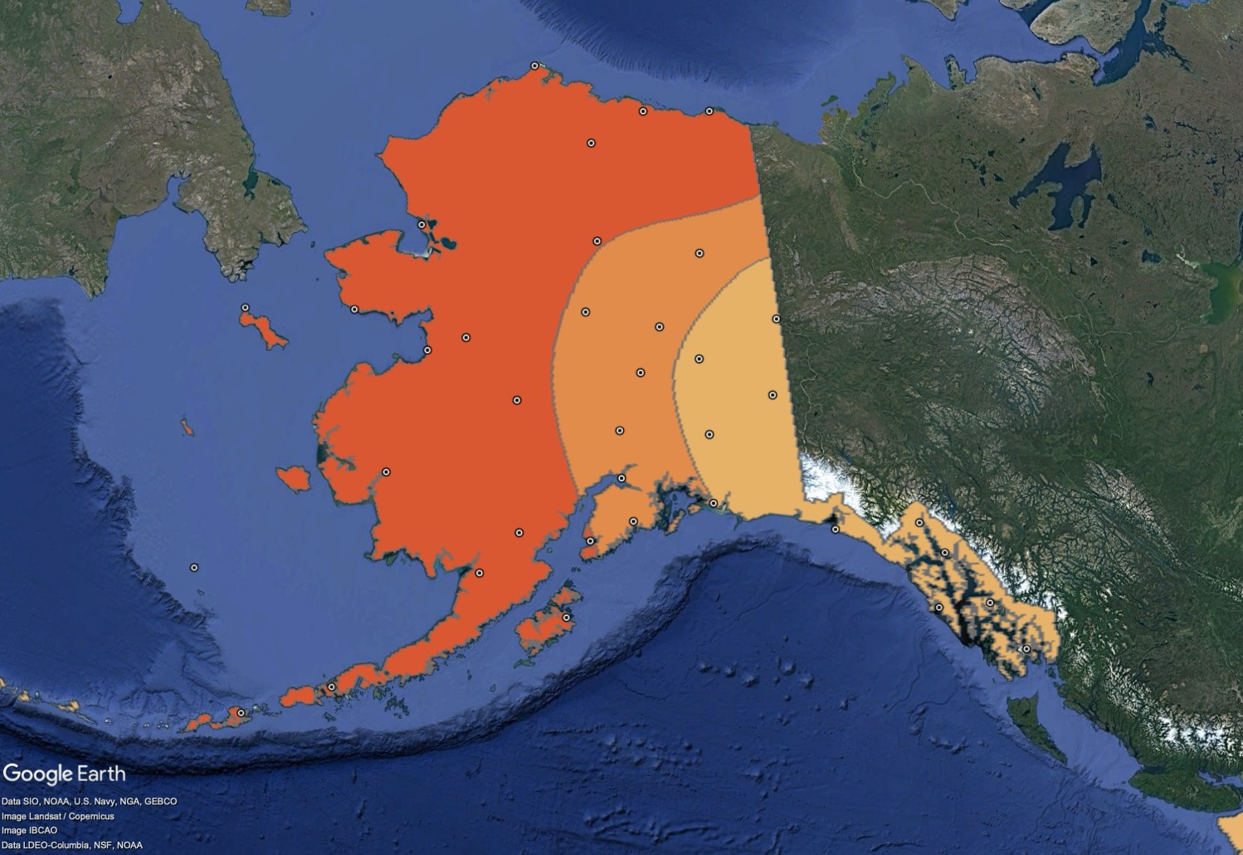
Jan-Feb-Mar 2020 Temperature Anomalies
Mid-Month Outlook
For areas CPC tilted the odds:
Percent correct: 08%
Observed
Skill Score: -37
Above Normal
Near Normal
Below Normal
Preliminary NOAA/NWS data subject to revision

Slide 7
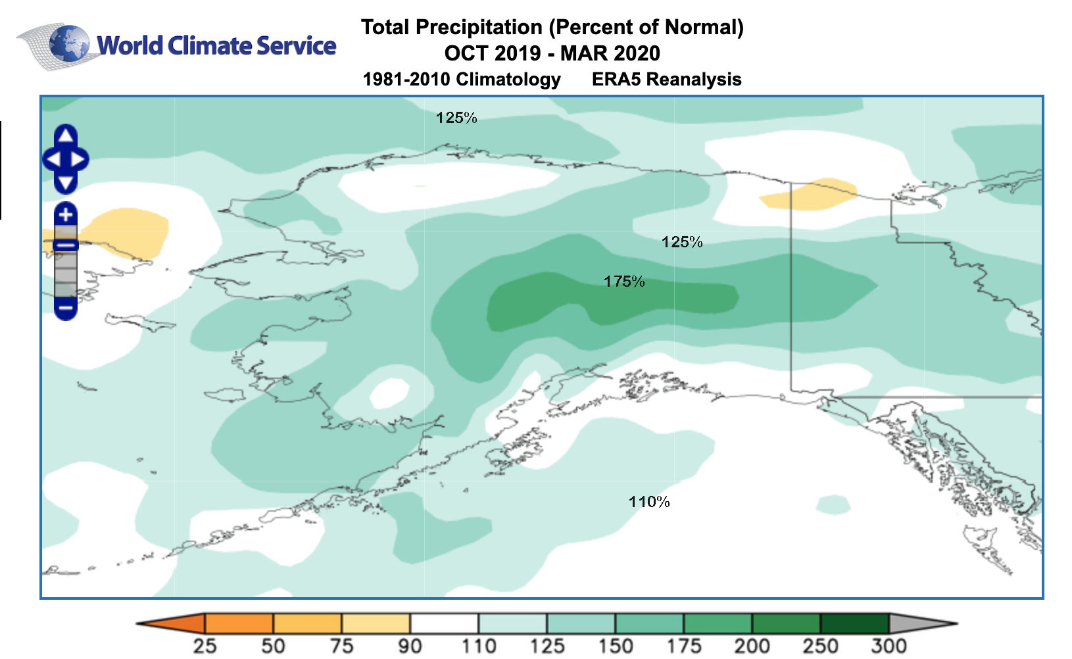
Cold Season 2019-20: Wet

Slide 8
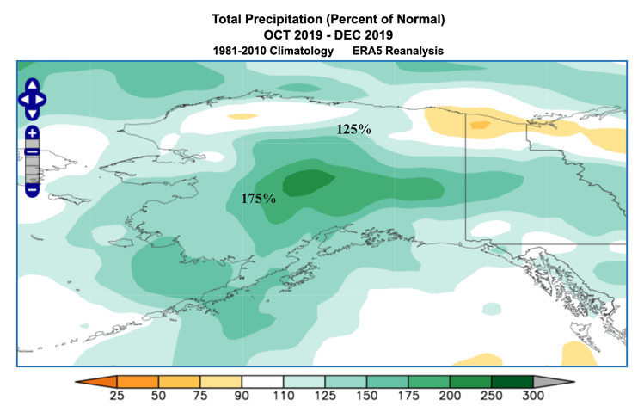
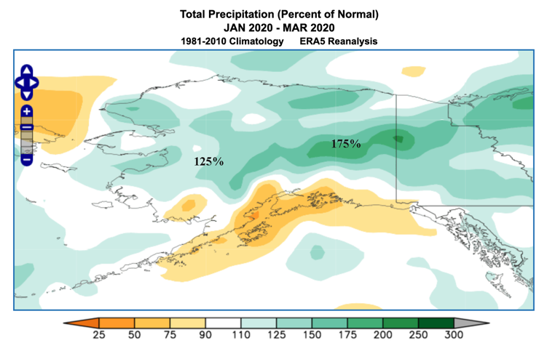
Less Difference in Precipitation
Oct-Dec 2019
Jan-Mar 2020

Slide 9
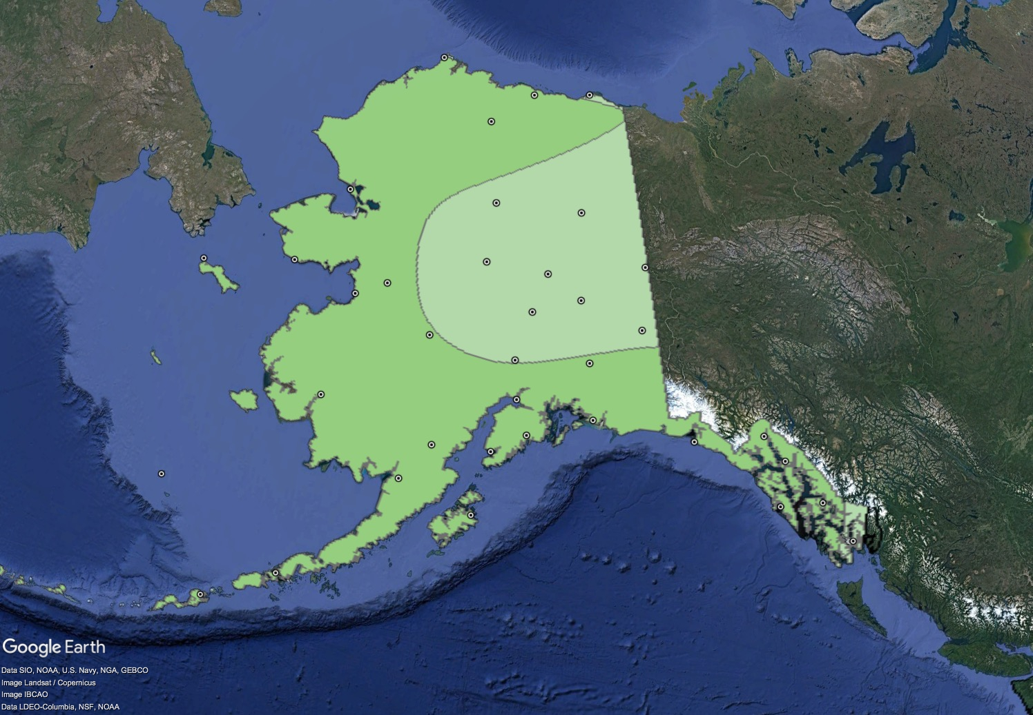
Oct-Nov-Dec 2019 Precipitation Anomalies
For areas CPC tilted the odds:
Percent correct: 85%
Observed
Skill Score: +79
Above Normal
Near Normal
Below Normal
Preliminary NOAA/NWS data subject to revision

Slide 10
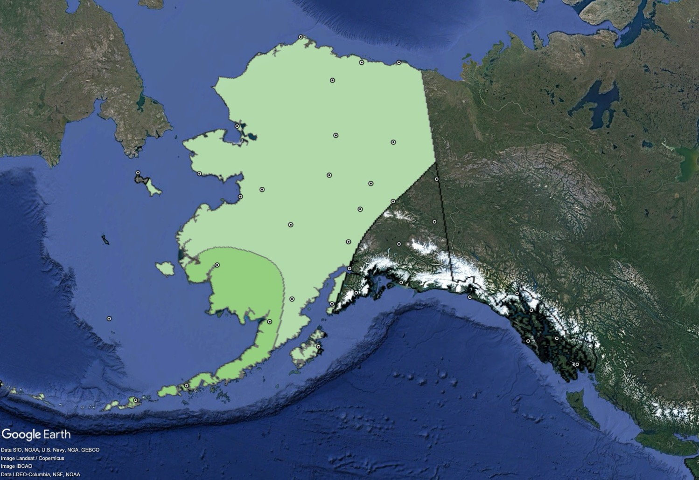
Jan-Feb-Mar 2020 Precipitation Anomalies
Mid-Month Outlook
For areas CPC tilted the odds:
Percent correct: 65%
Observed
Skill Score: +48
Above Normal
Near Normal
Below Normal
Preliminary NOAA/NWS data subject to revision

Slide 11
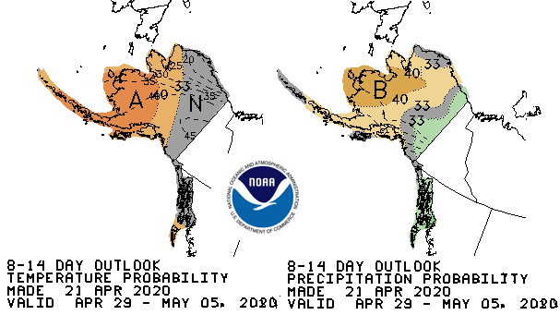
Climate Prediction Center Week 2

Slide 12
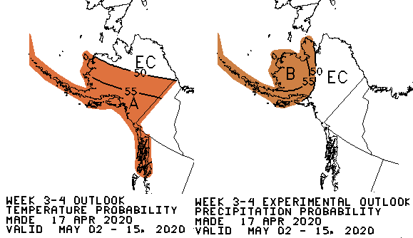
CPC Week 3-4 Outlooks Valid May 2-15, 2020

Slide 13
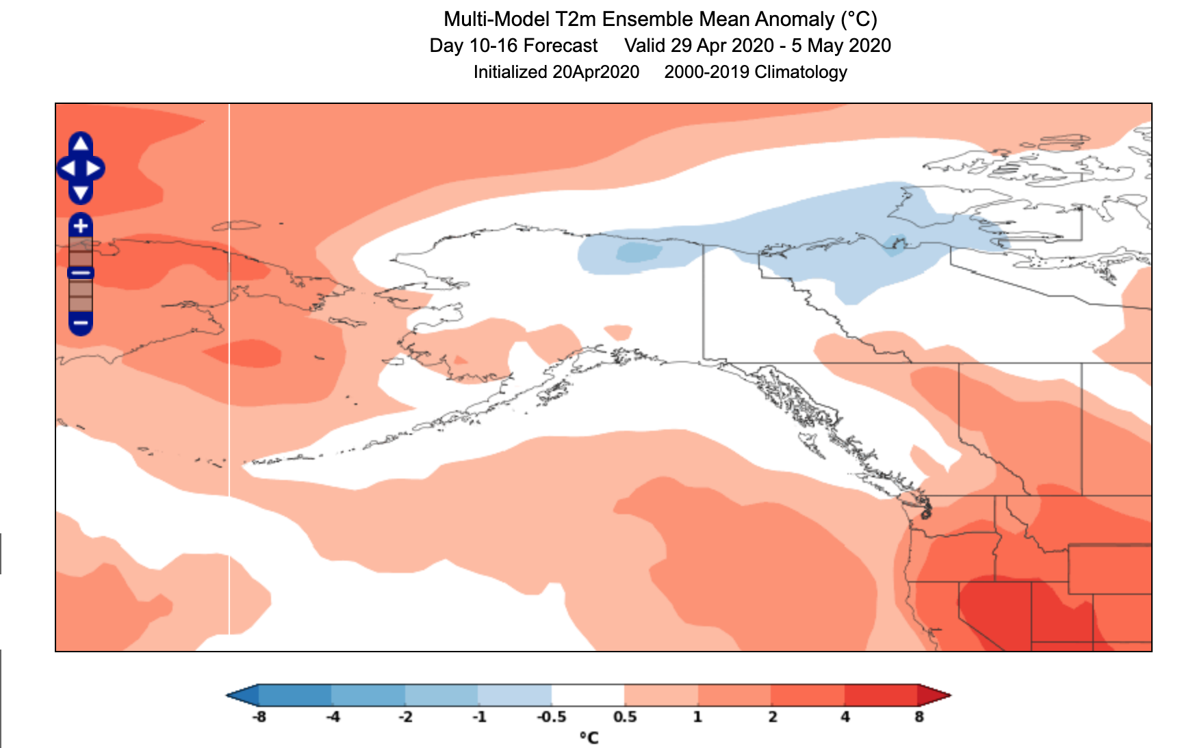
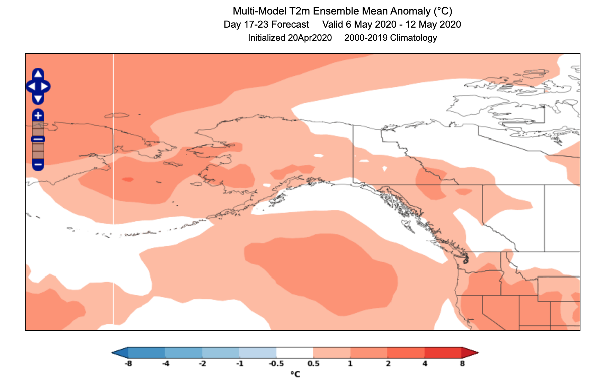
Weeks 2 and 3 Outlooks World Climate Service
Bias Corrected, Skill Weighted CFS + ECMWF ENS
April 29-May 05, 2020
May 06-12, 2020

Slide 14
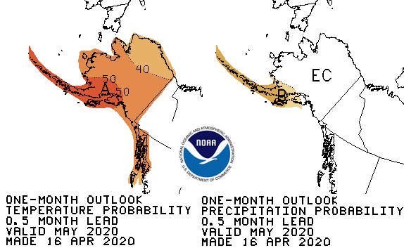
CPC May 2020 Outlook
45%
33%
22%
33%
33%
33%
37%
33%
30%
55%
33%
12%
30%
33%
37%
22%
33%
45%
45%
33%
22%
33%
33%
33%
Above%
Normal%
Below%

Slide 15
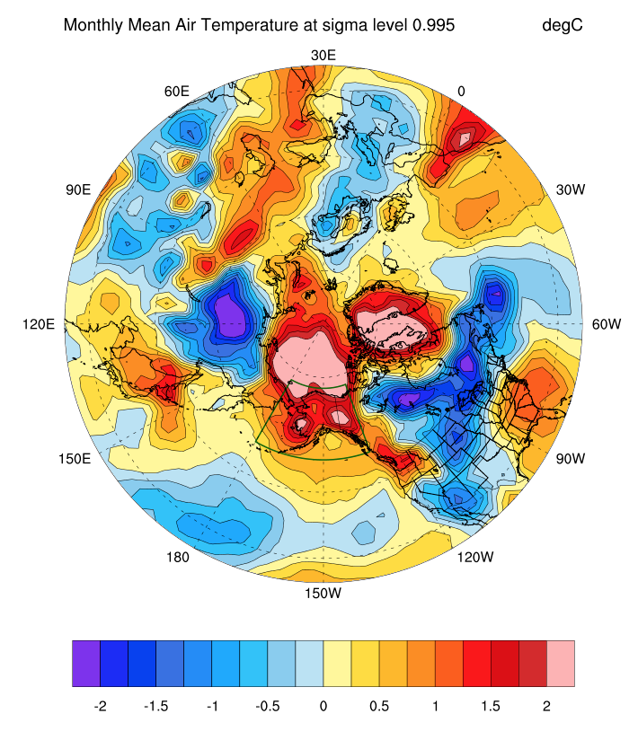
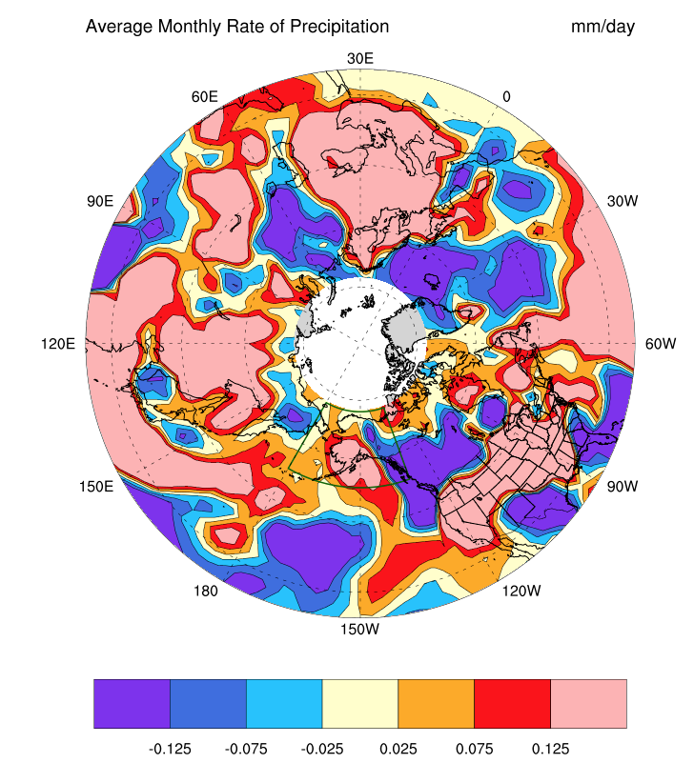
May 2020 Analog Outlooks
Analogs of JFM 2020
UAF/B. Brettschneider

Slide 16
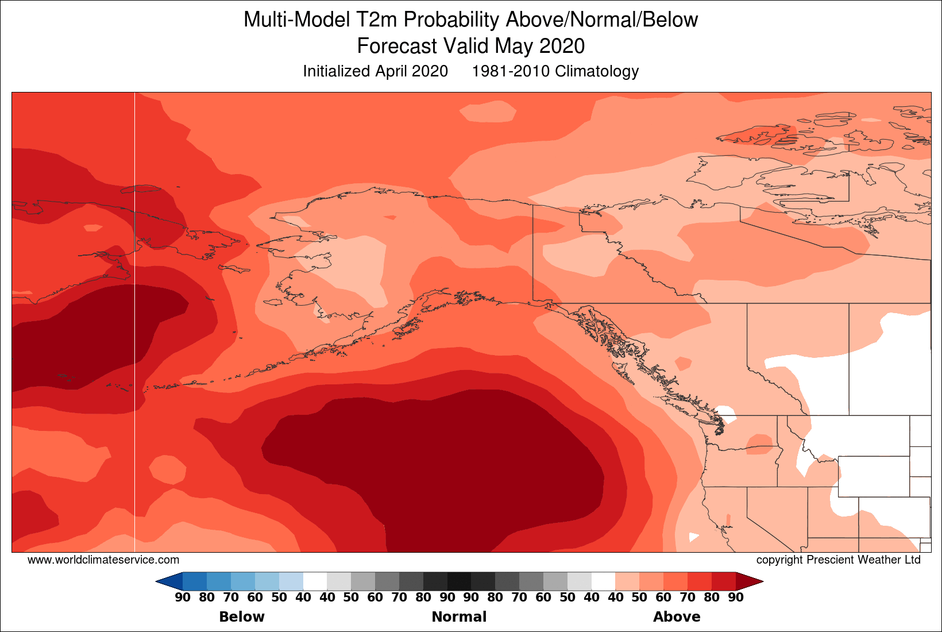
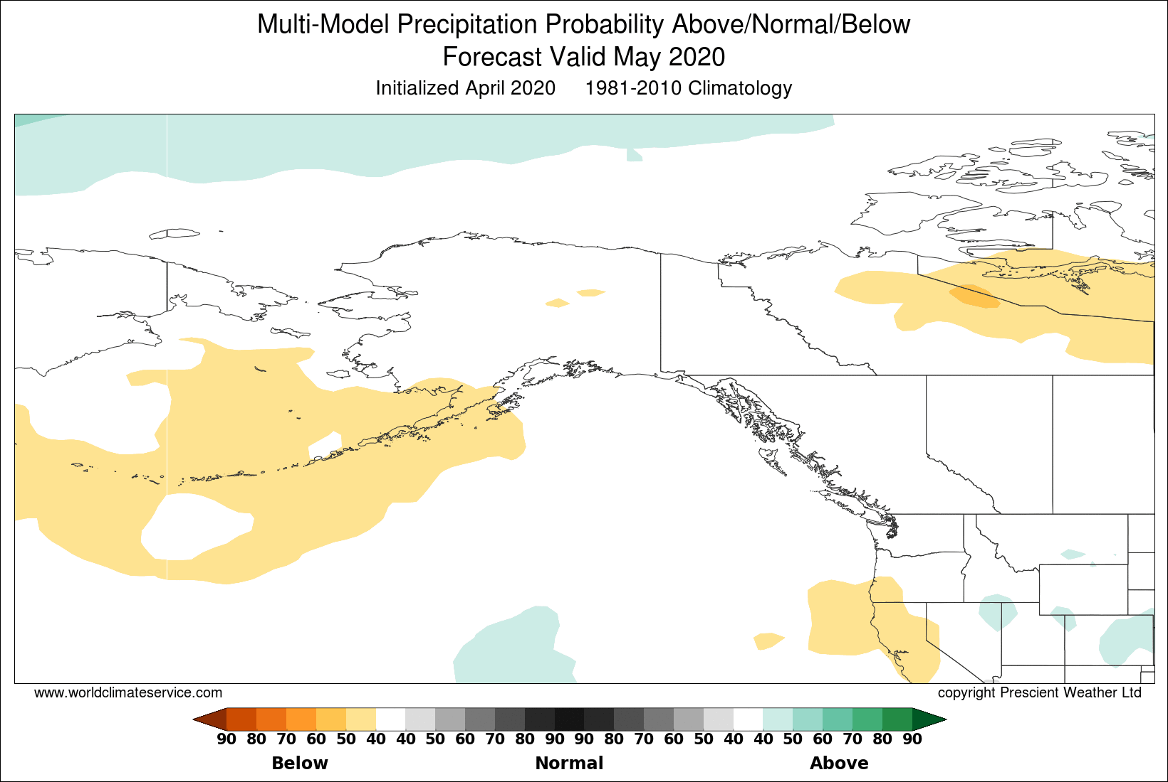
May Outlooks World Climate Service
Bias Corrected, Skill Weighted CFS + ECMWF ENS

